Slide 1
Agenda
Day 1 : About Data Science and Basics of Python
Day 2 : Python Core Data Structures
Day 3 : Functions and Modules
Day 4 : Exception handling
Day 5 : Numpy Package
Day 6 : Pandas Package
Day 7 : Data Manipulation with Pandas
Day 8 : Exercises
Day 9 : Recap

Slide 2
Data Science
What is Data Science
What is the need for Data science
The prerequisites for learning Data Science
What does a Data Scientist do? what are activities perform by them in a daily cycle
Demand for Data scientist

Slide 3
Python
What is Python
Python for Data Science
Anaconda Installation
Jupyter Notebook

Slide 4
What is Data Science
Data science is the study of data. It involves developing methods of
recording, storing, and analysing data to effectively extract useful
information. The goal of data science is to gain insights and knowledge
from any type of data — both structured and unstructured.

Slide 5
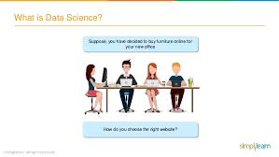
Suppose you have discussed to buy furniture online for your office
How do you choose the right website?

Slide 6
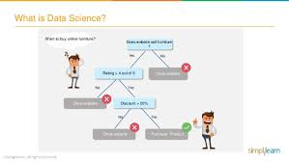
Want to buy online furniture?
Does Website sell furniture?
Yes
No
Rating > 4 out of 5
Close Website
No
yes
Close Website
Discount
No
Yes
Close Website
Purchase Product

Slide 7
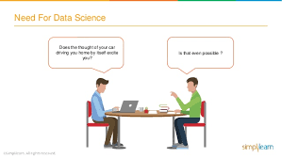
Does the thought of your car driving you home by itself excite you
Is that even Possible?

Slide 8
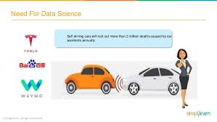
Self driving cars will root out more than 2 million deaths caused by car accidents annually

Slide 9
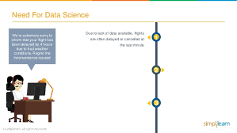
due to lack of data available flights are often delayed
or cancelled at the last minute
Dear Flyer, we regret to inform you that your flight has been cancelled due to delay
from Airbus on account of engine delivery
Due to improper route planning, customers don't get
the flight for desired time and duration
Incorrect decisions in selection of right equipment leads to unplanned delays and cancellations

Slide 10
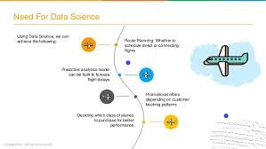
Using Data Science, we can
achieve the following
Route Planning: Whether to
schedule direct or connecting flights
Predictive analytics model
can be built to foresee flight delays
Promotional offers depending on
customer booking patterns
Deciding which class of planes
to purchase for better performance

Slide 11
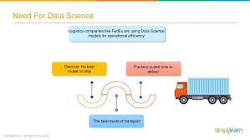
Logistics companies like FedEx are using
Data Science models for operational efficiency
Discover the best routes to ship
The best suited time to deliver
The best mode of transport

Slide 12
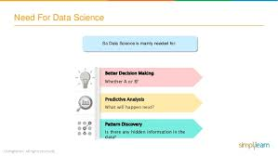
So Data Science is mainly needed for:
Better Decision Making
Whether A or B?
Predictive Analysis
What will happen next?
Pattern Discovery
Is there any hidden information in the data?

Slide 13
Factors for Comparison | Python | R | SAS
Overview | A widely used object-oriented language, emphasizing on productivity and code readability. | A flexible and powerful scripting language and the open source counterpart to SAS. | A prominent data analytical tool in the market with wide-ranging capabilities and extensive preference by huge corporates.
Cost | Python and R are free programming languages that can be downloaded and used by individuals as well as organizations. |  | Although SAS has introduced a free University edition, it is a proprietary software and companies need to pay a huge amount to make use of SAS in their system.
Updates | Both are open source and hence updates are quickly available |  | Updates are available only through periodic new version roll-outs
Learning Ease | Python has the advantage of being simple to learn and can be used by beginners as well as experienced data scientists. | With the steepest learning curve among the three, R is a difficult language to learn as it needs a working knowledge of coding. | SAS is easy to learn, being similar to SQL. Programmers who have worked with SQL, find it quite easy.
Speed | It is a high level programming language and the ideal choice for critical yet fast applications. | Since it is a low-level programming language, longer codes are needed for simple procedures resulting in reduced speed. | Due to the drag and drop feature, components can be picked up and used directly, without worrying about the coding part.
Data Handling Capability | All three languages score similarly as far as data handling capability is concerned. They have good data handling capacity and can handle parallel computations.
Graphical Capabilities | Python has its own packages like Vispy and Matplotlib providing excellent graphical capabilities. | With ggplot, Lattice, RGIS and other such packages, R provides the best visualization diversity among the three. | Though SAS has been working recently to improve its graphical capabilities, it comes nowhere near the other two.
Customer Support | Being free, there is no customer support but, a very huge online community support is available to answer problems | A large online community for support but not as large as that for python. | Excellent customer support at corporate level to troubleshoot any issue.
Popularity | Python has recently seen unprecedented growth and is set to outpace the other 2 languages in the market. | Hugely popular with statisticians and individual programmers due to its huge repository and flexibility. | The most popular in the corporate world and used by most of the huge corporations for at least some aspect of their functioning.

Slide 14
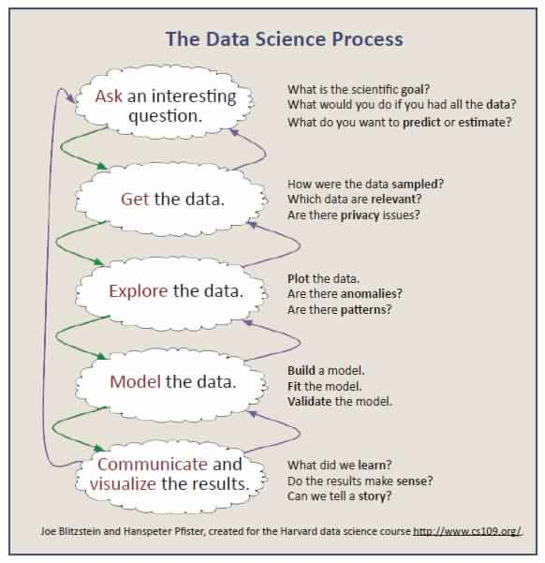

Slide 15
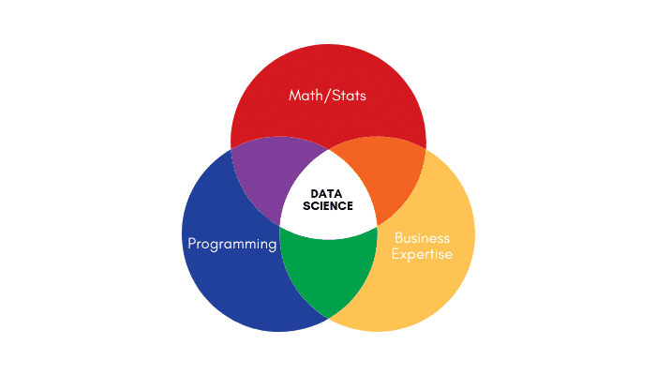
PREREQUISITES FOR
DATA SCIENCE

Slide 16
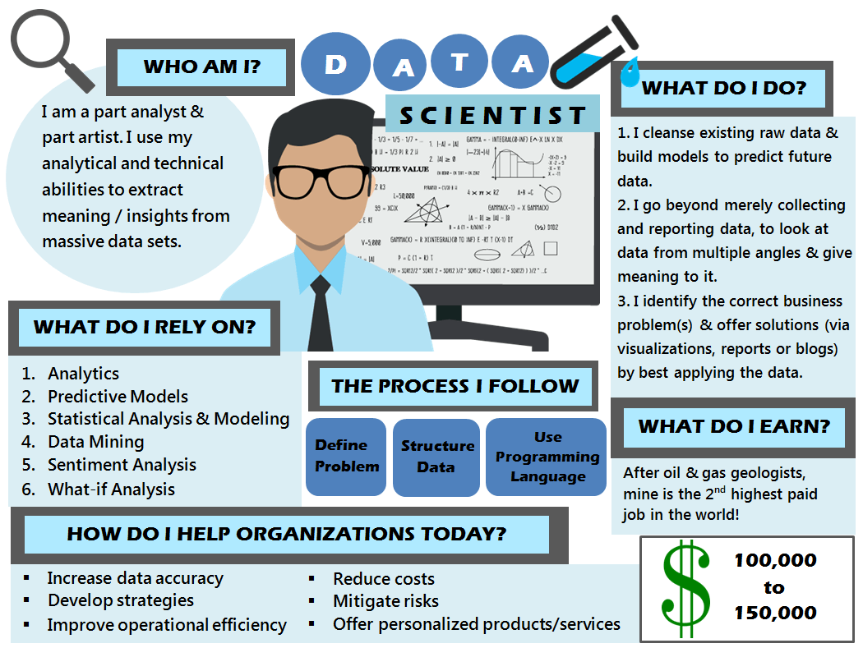
What does Data Scientist do?

Slide 17
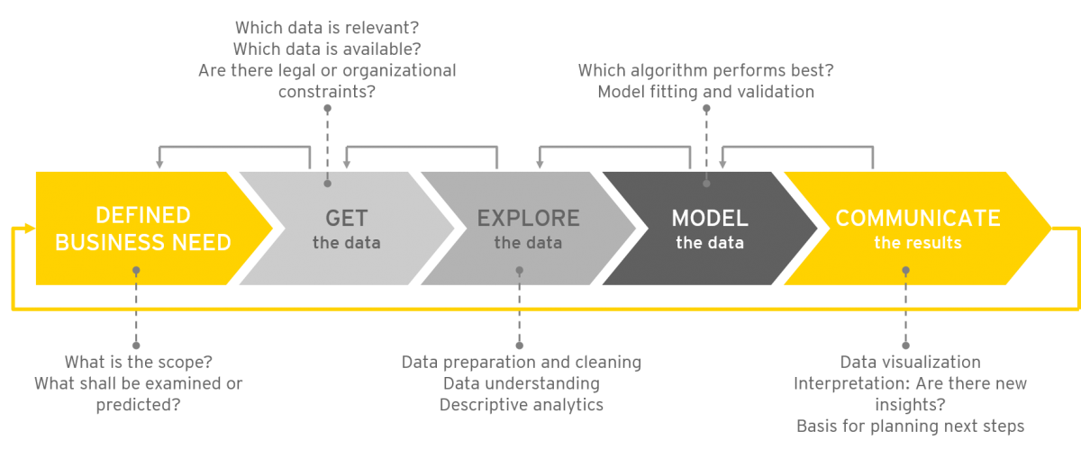

Slide 18
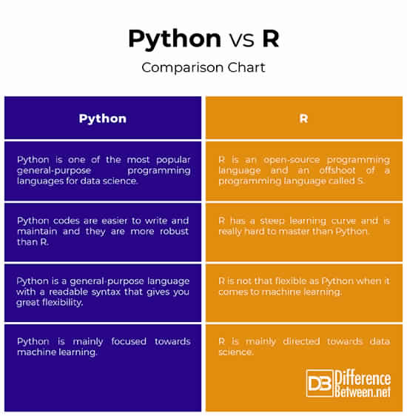
Tools used in Data Science

Slide 19
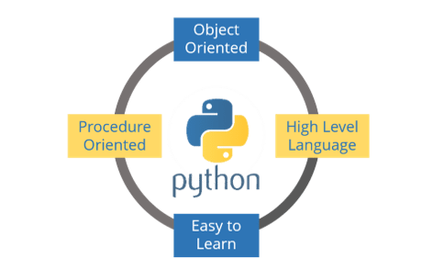

Slide 20
Object Oriented language:
Python is multi- paradigm language, means it supports different programming approach.
High level language:
Reading and writing codes in much like regular English statements. They are not written in machine readable language.
Interpreted language:
Interpreter runs through the code and translate it into machine readable byte code.

Slide 21
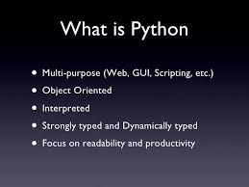

Slide 22
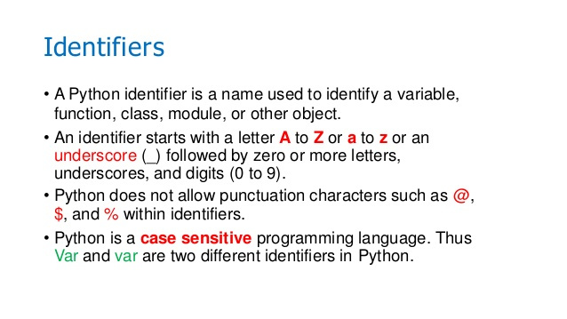

Slide 23
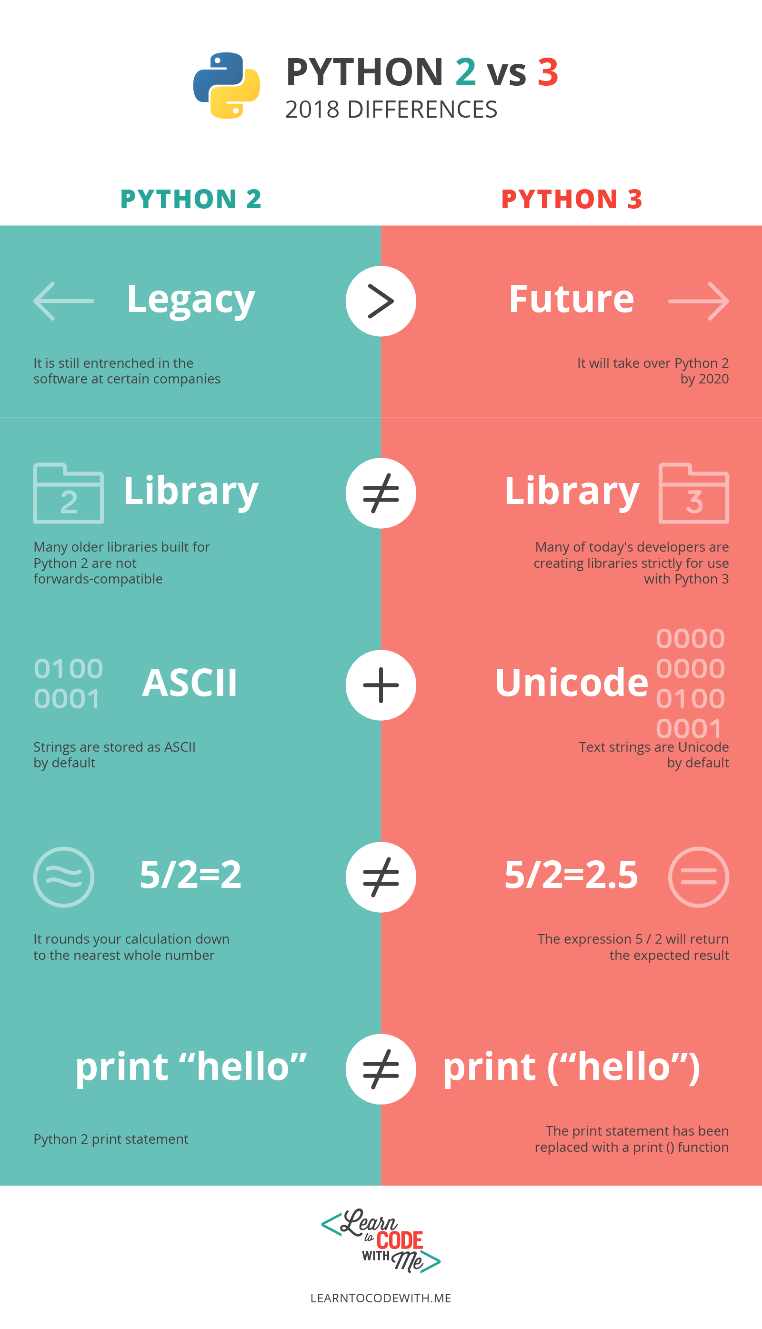
Python 2 Vs Python 3

Slide 24
ANACONDA INSTALATION

Slide 25
DAY - 2

Slide 26
Introduction to Python for Data Science
Basics of Python
Python Core Data Structures
Iterabels and iterators
Functions and Methods
Lambda and map
List Comprehension

Slide 27
Data Structures in Python
Int, Float [Numeric] (Basic Data Types) Bool [Logical] Strings [Character] List Tuple Dictionary

Slide 28
Class – Exercise Data Structures

Slide 29
Iterables and Iterators: An iterable is an object, that can return an iterator. An iterator is a value factory.
The iterable
X=[1,2,3]
iterator y→1
→2
→3
y=iter(x))

Slide 30
Functions: Functions are named blocks of code, designed to do one specific job. Code reusability
Methods: Methods are like a python function. But it must be called on an object.
User defind function
Built in function
Lambda and map function: A lambda function is a small anonymous function. It can take any number of arguments, but can only have one expression. Syntax: lambda arguments: expression Map function returns a list of the results after applying the given function to each item of a given iterable. Syntax: Map(func,iter)
def name(): print (“hello”)

Slide 31
Files: Read & Write To read from a file your program needs to open the file and then read the contents of the file. You can read the entire contents of the file ,by using ‘with’ statement. with open(filename) as f_obj: contents=f_obj.read() Writing to an empty file. filename = 'programming.txt' with open(filename, 'w') as f: f.write("I love programming!")
List slicing: A portion of a list is called a slice. To slice a list start with the index of the first item you want, then add a colon and the index after the last item you want. Leave off the first index to start at the beginning of the list, and leave off the last index to slice through the end of the list. L1[start:end]
List Comprehension: To write a comprehension, define an expression for the values you want to store in the list. Then write a for loop to generate input values needed to make the list. A one line expression of a for loop squares = [x**2 for x in range(1, 11)]

Slide 32
